Slide 1
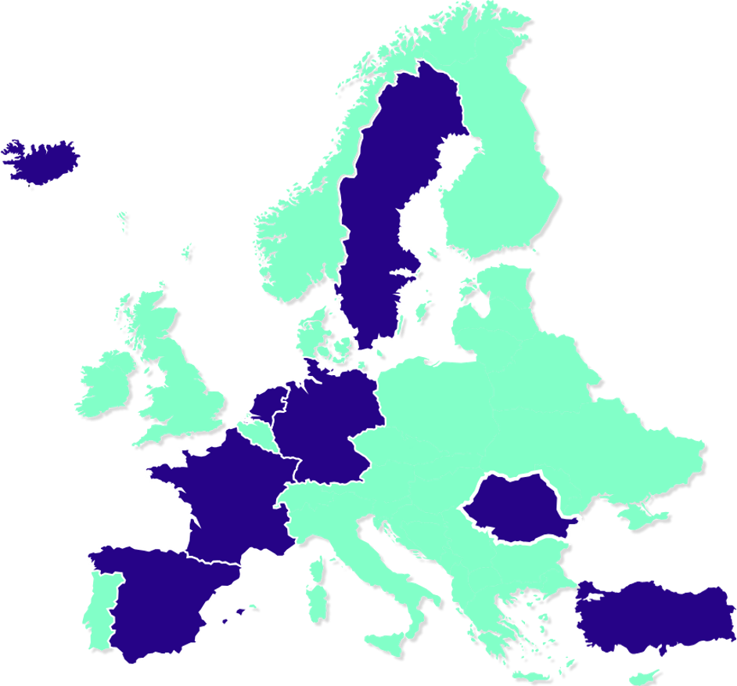
The European University of Brain and Technology - NeurotechEU
NeurotechEU, an alliance of eight leading European universities, aims to establish neurotechnology as an applied science and deliver transformative technologies for, from, and with the brain.
By integrating AI and medicine, NeurotechEU addresses neurological challenges through a foundation of education, research, innovation, and mobility.
NeurotechEU Benefits:
For Society:
Better diagnostics, therapies, and health systems.
Ethical innovation and stronger European research.
Economic and social improvements.
For Students:
Multidisciplinary education and international mobility.
Cutting-edge research access and career opportunities.
Inclusion in a diverse, global community.
For Academics:
Collaborative research, partnerships, and shared infrastructure.
Mobility and advancements in research methods.

